Slide 1
Mechanisms and Robotics Laboratory

Slide 2
Contents
Matlab Introduction
What is MATLAB?
MATLAB Desktop
Matrices and Arrays
Operators (Arithmetic, relational, logical )
Flow Control
Using of M-File
Importing data
Notes:
References:
https://opentextbc.ca/teachinginadigitalage/chapter/section-8-1-a-short-history-of-educational-technology/?utm_source=timminstoday.com&utm_campaign=timminstoday.com&utm_medium=referral
https://www.riemysore.ac.in/ict/unit__7__elearning.html#7.5
https://www.youtube.com/watch?v=jTH3ob1IRFo
Skinner, B. (1968) The Technology of Teaching, 1968. New York: Appleton-Century-Crofts

Slide 3

What is MATLAB?
The name MATLAB stands for MATrix LABoratory.
Designed by Cleve Moler
Founder of Math works
Website mathworks.com/products/matlab
MATLAB is a high-performance language for technical computing. It integrates computation, visualization, and programming environment.
Furthermore, it has sophisticated data structures, contains built-in editing and debugging tools, and supports object-oriented programming.
These factors make MATLAB an excellent tool for teaching and research.
Cleve Moler

Slide 4
What is MATLAB
Advantages
Ease of Use
Platform Independence
Predefined Functions
Device-Independent Plotting
Graphical User Interface
MATLAB Compiler
Disadvantages
Computational time
Cost

Slide 5
MATLAB Desktop
Features
Command Window
Command History Window
Current Directory Browser
Workspace Browser
Array Editor
Editor/Debugger
Figure Windows
Help Browser

Slide 6
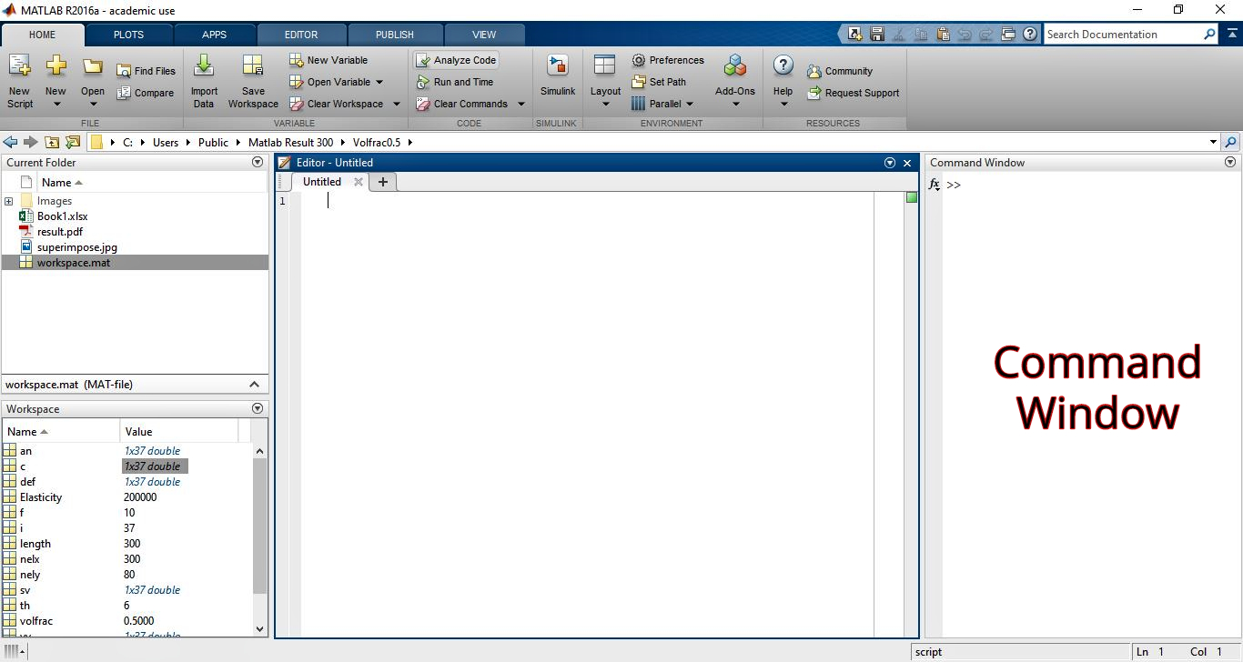
Command Window
The right-hand side of the default MATLAB desktop contains the Command Window. A user can enter interactive commands at the command prompt (») in the Command Window, and they will be executed on the spot.

Slide 7
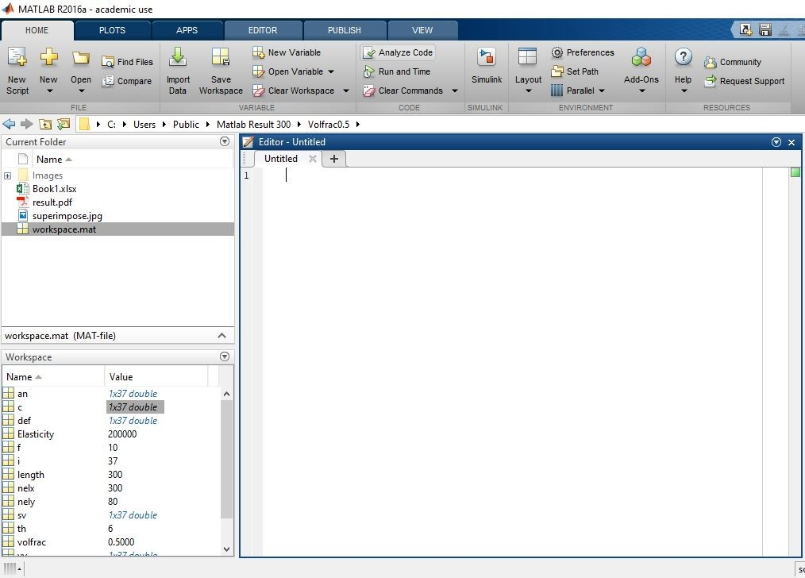
Current Directory Browser
An Edit Window is used to create new M-files, or to modify existing ones. An Edit Window is created automatically when you create a new M-file or open an existing one. To search for, view, open, and make changes to MATLAB related directories and files, use the MATLAB Current Directory browser. Alternatively, you can use the functions dir, cd, and delete. Use the Visual Directory and Directory Reports to help you manage M-files.

Slide 8
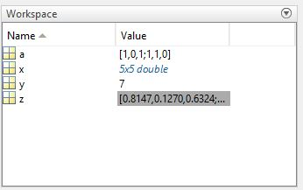
Workspace Browser
The MATLAB workspace consists of the set of variables (named arrays) built up during a MATLAB session and stored in memory. To view the workspace and information about each variable, use the Workspace browser.
Command | Outcome
clear | Clears the workspace, all variables are removed from the memory
clear x y z | Clears only variables x, y, and z
clear all | Clears all variables and functions from workspace
who | Lists variables currently in the workspace
whos | Lists variables currently in the workspace with their sizes together with information about their bytes and class

Slide 9
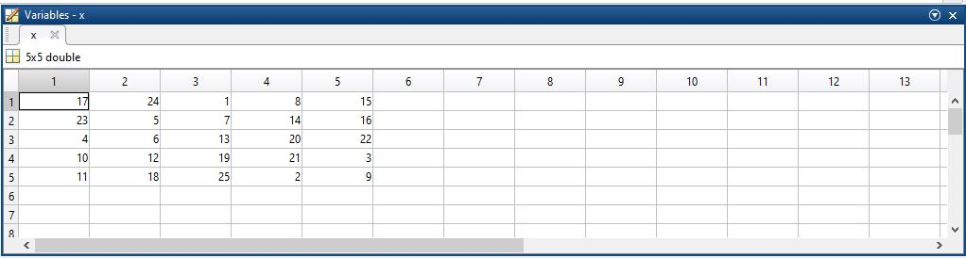
Array Editor
Double-click a variable in the Workspace browser, or use openvar variable name, to see it in the Array Editor. Use the Array Editor to view and edit a visual representation of variables in the workspace.

Slide 10
Editor/Debugger
Use the Editor/Debugger to create and debug M-files, which are programs you write to run MATLAB functions. The Editor/Debugger provides a graphical user interface for text editing, as well as for M-file debugging.
Scripts and Functions
There are two kinds of M-files:
Scripts, which do not accept input arguments or return output arguments. They operate on data in the workspace.
Functions, which can accept input arguments and return output arguments. Internal variables are local to the function.

Slide 11
Line style
Line style, marker symbol, and color, specified as a string. The elements of the string can appear in any order, and you can omit one or more options from the string specifier. If you omit the line style and specify the marker character, then the plot shows only the marker and no line.
Example: '--or' is a red dashed line with circle markers
Specifier | Line Style
- | Solid line (default)
-- | Dashed line
: | Dotted line
-. | Dash-dot line

Slide 12
Marker symbol
Specifier | Marker
o | Circle
+ | Plus sign
* | Asterisk
. | Point
x | Cross
s | Square
d | Diamond
^ | Upward-pointing triangle
v | Downward-pointing triangle
> | Right-pointing triangle
< | Left-pointing triangle
p | Pentagram
h | Hexagram

Slide 13
Color
Specifier | Color
y | yellow
m | magenta
c | cyan
r | red
g | green
b | blue
w | white
k | black

Slide 14
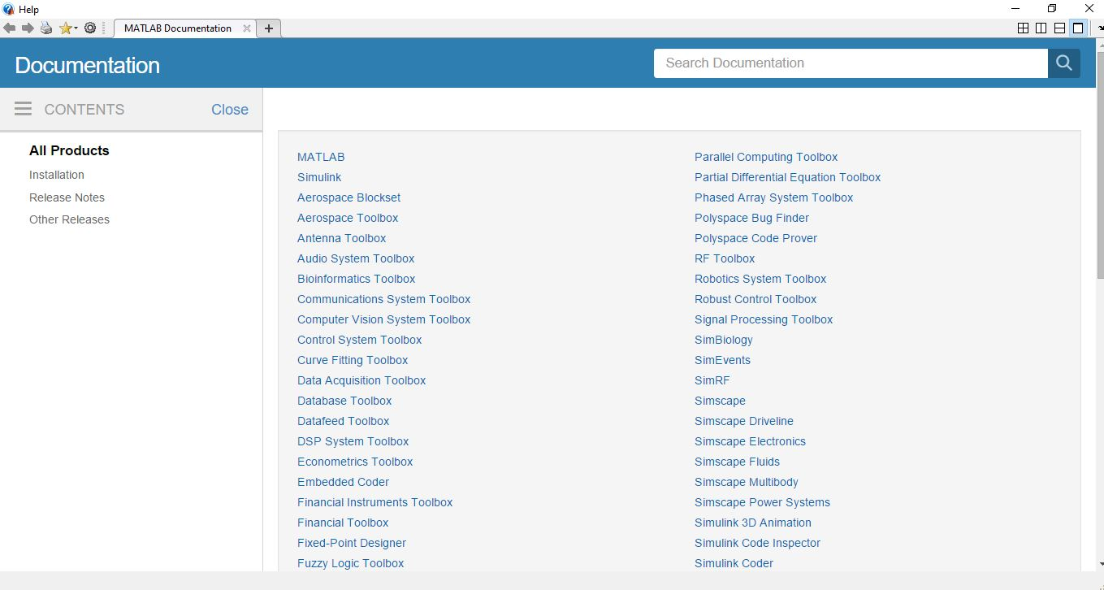
Help Browser
There are several ways to get help in MATLAB.
helpdesk
helpwin
help function
lookfor keyword
doc Keyword

Slide 15
Arrays and Matrices
An array is a collection of values that are represented by a single variable name. One dimensional arrays are called vectors and two-dimensional arrays are called matrices.
Entering Matrices
Separate the elements of a row with blanks or commas.
Use a semicolon “ ; ” to indicate the end of each row.
Surround the entire list of elements with square brackets [ ].

Slide 16
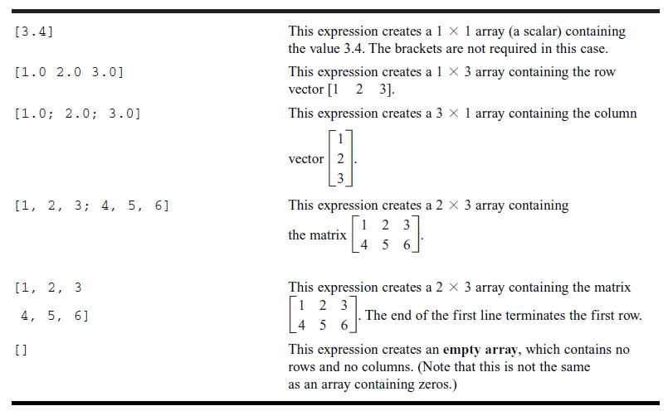
Types of Arrays

Slide 17
Matrices Operations
sum
transpose
Diagonal
Magic
Swap columns/rows
Delete columns/rows
Concatenating
Ones
Zeros
Size
Inverse
Determinant
Eigenvalues and eigenvectors
Random numbers

Slide 18
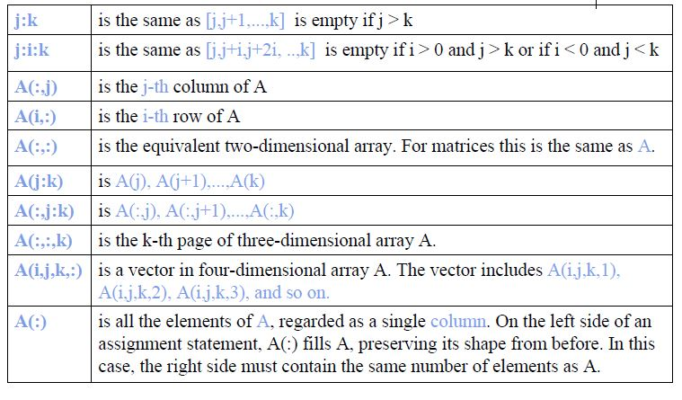
The Colon Operator

Slide 19
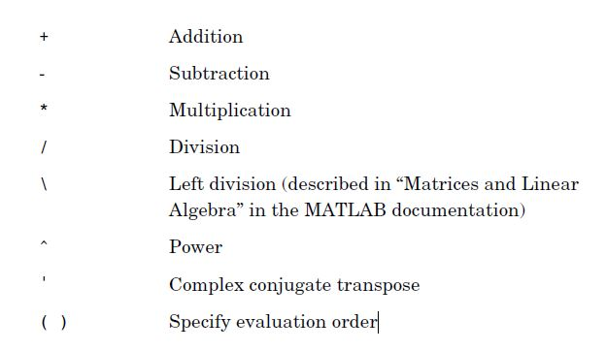
Operators (Arithmetic)

Slide 20
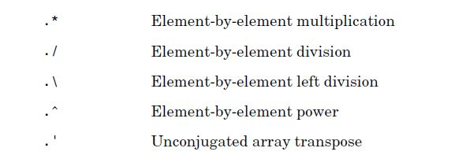
Element by element Operators

Slide 21
Matlab Relational Operators
MATLAB supports six relational operators
Less Than <
Less Than or Equal <=
Greater Than >
Greater Than or Equal >=
Equal To ==
Not Equal To ~=

Slide 22
Matlab Logical Operators
MATLAB supports three logical operators.
not ~ % highest precedence
and & % equal precedence with or
or | % equal precedence with and

Slide 23
Flow Control
For loop Syntax
for index = values
Statements
end
While loop Syntax
While expression
Statements
end

Slide 24
Flow Control
if, else if, else loop Syntax
if expression
Statements
elseif expression
statements
else
Statements
end

Slide 25
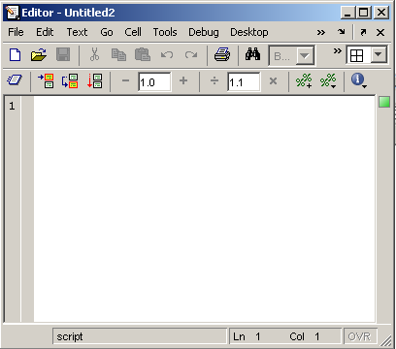
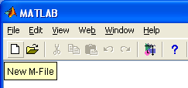
Using of M-File
Click to create a new M-File
Extension “.m”
A text file containing script or function or program to run

